Slide 1
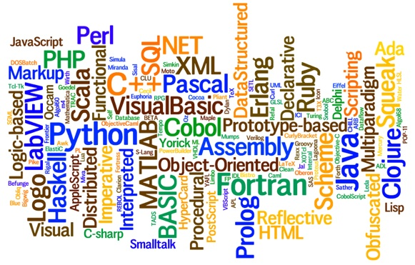
CS445 Programming Languages Slides 7 – Syntax of Programming Languages
By Talha Waheed, UET Lahore

Slide 2
Course Learning Objective

Slide 3
Programming Languages Syntax
Syntax - the form or structure of the expressions, statements, and program units
Semantics - the meaning of the expressions, statements, and program units

Slide 4
Users of Language Definitions
Other Language Designers
Language Implementers
Programmers

Slide 5
Some Definitions (from Th. of Automata)
A sentence is a string of characters over some alphabet
int a = 0;
A language is a set of sentences
L= { x | all valid identifiers of C language}
A lexeme is the lowest level syntactic unit of a language (e.g., *, sum, begin)
A token is a category of lexemes (e.g., identifier)

Slide 6
General Syntactic Criteria
Primary purpose of the syntax is to provide a notation for communication between the programmer and the compiler.
Criteria
Readability
Writeability
Ease of translation
Lack of ambiguity

Slide 7
Readability (Revisited)
Self-documenting (No comments)
Natural statement format
Structured statements
Liberal use of keywords and noise words
Comments style
Mnenomic operator symbols e.g. != vs. NE

Slide 8
SNOBOL Example
One Statement Format in SNOBOL
label subject pattern = replacement :goto
hard to differentiate among an assignment statement, a subprogram call, a simple goto statement, a subprogram return, a multi-way conditional branch.
Example
BEGIN LINE = INPUT
LINE "QUIT" :S(END)
OUTPUT = LINE :(BEGIN)
END
{This will read lines from input and print to output until QUIT is found anywhere in the input line.}

Slide 9
Writeability (Revisited)
Writeability is sometime in conflict with readability
Implicit vs. Explicit Typing in declaration
Implicit vs. Explicit Type Conversion e.g.
i = j + c vs. i = j + into_integer(c)
Some are common with Readibility
Unrestricted identifier (length)
Free vs. fixed field format (C vs. COBOL)
Free field format if statement may be written anywhere
Mnemonic operation symbols e.g. != vs. NE

Slide 10
Lack of Ambiguity
Two or more different interpretations of same sentence.
FORTRAN – A(i,j)
Is it a function call or 2D array location?
vs.
Pascal – A(i,j) and A[i,j]
Here Both are different
Problem of dangling else (will see it later)

Slide 11
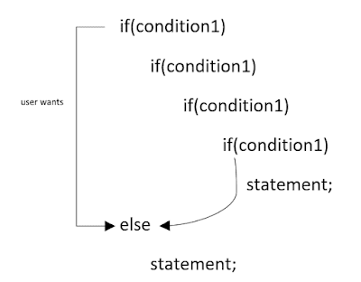
Dangling else (Apply some rule)
S → if E then S
| if E then S else S

Slide 12
Dangling else (Apply brackets)
S → if E then S
| if E then S else S
if E1 then {if E2 then S1 else S2}
if E1 then {if E2 then S1} else S2

Slide 13
Dangling Else (Revised Grammar)
S → M | U
M → if E then M else M | A
U → if E then S
| if E then M else U
Where M is for matched and U is for Unmatched

Slide 14
Dangling else (Introducing Keyword)
S → if E then S end if
| if E then S else S end if
S → if E then S else S endif
| if E then S elsif S else S endif

Slide 15
Ease of Translation
Key to ease of translation is the regularity of the Syntax
In C, Boolean and arithmetic expressions are inter-changeable.
LISP – very simple rules because of the regularity of the syntax
Programs become hard to translate as the number of special syntactic constructs or exceptions increases.
E.g. j++, ++j, j = j+1, j += 1; Exception in C parameter passing (int. vs. array)

Slide 16
Levels of Syntax (As per Chomsky Hierarchy)
Words – the lexical level, determining how characters form tokens;
(Type 3: Regular Grammar or Regular Expressions)
Phrases/Statments – the grammar level, narrowly speaking, determining how tokens form phrases;
(Type 2: Context-Free Grammar)
Context – determining what objects or variables names refer to, if types are valid, etc.
(Type 1: Context-Sensitive Grammar)

Slide 17
Major Notations for Statement Syntax of PL
Context Free Grammar
Backus Naur Form
Rail Road Diagrams

Slide 18
Context Free Grammar (CFG)
Developed by Noam Chomsky in the mid-1950s
Language generators, meant to describe the syntax of natural languages
Defines a class of languages called context-free languages (CFL)

Slide 19
Backus Normal Form – BNF (1959)
by John Backus to describe Algol 58
BNF = CFG
BNF is a meta-language for programming languages
In BNF, abstractions (or nonterminal) are used to represent classes of syntactic structures - they act like syntactic variables
Syntactic lists are described in BNF using recursion
<ident_list> → ident | ident, <ident_list>
E.g. while statement using BNF rule
<while_stmt> → while <logic_expr> do <stmt>

Slide 20
Example - A BNF Grammar and Derivation
<program> → <stmts>
<stmts> → <stmt> | <stmt> ; <stmts>
<stmt> → <var> = <expr>
<expr> → <term>+<term>| <term>-<term>
<term> → <var> | const
<var> → a | b | c | d
Leftmost Derivation of input: a = b + const
<program> => <stmts> => <stmt> => <var> = <expr> => a = <expr> => a = <term> + <term> => a = <var> + <term> => a = b + <term> => a = b + const

Slide 21
Derivation
Repeated application of rules, starting with start symbol and ending with a sentence (all terminal symbols)
Every string of symbols (intermediate form) in the process of derivation is called a sentential form
Vs.
A sentence is a sentential form that has only terminal symbols (final form)
A leftmost/rightmost derivation is one in which the leftmost/rightmost nonterminal in each sentential form is the one that is expanded

Slide 22
Examples of Left and Rightmost Derivations
Grammar E → E+E | E*E | a
Leftmost derivation: the leftmost non-terminal is always reduced:
E => E*E => E+E*E => a+E*E => a+a*E => a+a*a
Rightmost derivation: the rightmost non-terminal is always reduced:
E => E+E => E+E*E => E+E*a => E+a*a => a+a*a

Slide 23
Parse Tree
A graphical/hierarchical representation of derivations
Visually appealing, did not provide sequence once completed. (Where derivation provide linear sequence)
2 Parse Trees from previous example of derivation: showing ambiguity
E
E
E
*
E
E
+
E
E
+
E
a
a
E
*
E
a
a
a
a

Slide 24
Ambiguous Grammar
A grammar is ambiguous iff it generates a sentential form for a single phrase that has two or more distinct parse trees. (any other definition?)
Two Leftmost/rightmost derivations for same sentence
Just one phrase with two trees is proof of ambiguity in grammar.
Not ambiguous? All phrases must have only one parse tree!
Very difficult to show
An ambiguous grammar is quite different from an inherently ambiguous language (that has no simple solution)

Slide 25
Operator Precedence (ambiguous)
Grammar: E → E + E | E * E | (E) | id
Input: a + a * a
E
E
E
*
E
E
+
E
E
+
E
a
a
E
*
E
a
a
a
a

Slide 26
Operator Precedence (unambiguous)
If we use the parse tree to indicate precedence levels of the operators, we cannot have ambiguity
Original Grammar E → E + E | E * E | (E) | id
Rewritten Grammar:
E → E + T | T
T → T * F | F
F → (E) | id
Where E = expression, T = term and F = factor
E
E
+
T
T
T
*
F
F
F
a
a
a
Input: a + a * a

Slide 27
Operator Associativity
Ambiguous Grammar: E → E + E | id
input : a + b + c
E
E
E
+
E
E
+
E
E
+
E
c
a
E
+
E
a
b
E
b
c
Revised Grammar: E → E + id | id
E
+
E
E
+
E
c
a
b

Slide 28
Operator Associativity Impact on semantics
E → E - E | id
Input: a - b - c
// semantically incorrect
// semantically correct
// advantage – optimization is possible
E → E + E | id
Input: a + b + c
a = 5
b = a++ + --a
// undefined semantics??

Slide 29
Extended BNF (EBNF)
Optional parts are placed in square brackets [ ]
<proc_call> → ident [ ( <expr_list>)]
Put alternative parts of RHSs in round brackets () and separate them with vertical bars
<term> → <term> (+ | -) const
Put repetitions (0 or more) in curly brackets { }
<ident> → letter {letter | digit}

Slide 30
BNF vs EBNF - Example
BNF:
<expr> -> <expr> + <term>
| <expr> - <term>
| <term>
<term> -> <term> * <factor>
| <term> / <factor>
| <factor>
EBNF:
<expr> -> <term> {(+ | -) <term>}
<term> -> <factor> {(* | /) <factor>}

Slide 31
Syntax Graphs (Rail Road Diagrams)
put the terminals in circles or ellipses and put the nonterminals in rectangles; connect with lines with arrowheads
e.g., Pascal type declarations
Type identifier
(
Identifier
)
,
constant
constant
..

Slide 32
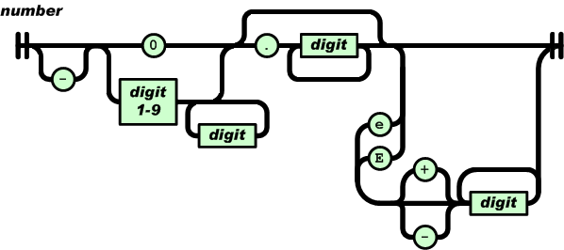
Railroad Diagram Numbers Example
Examples
Minimum: 0.0
A large one: -123456789.987654321E-123456789

Slide 33
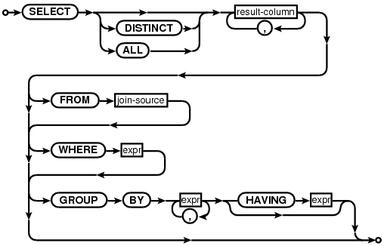
Railroad Diagram SQL Example

